Slide 1
Jermyn Borough Council Meeting
1/15/2026

Slide 2

Meeting Agenda
JANUARY 15,2026
CALL TO ORDER
PLEDGE OF ALLEGIANCE
ROLL CALL
PREVIOUS MEETING MINUTES (BOTH DECEMBER 18 AND RE-ORG MEETINGS)
CORRESPONDENCE
TREASURERS REPORT /BILLS PAYABLE
SECRETARY REPORT
PUBLIC COMMENT
SOLICITOR REPORT
POLICE CHIEF REPORT
ENGINEERING REPORT
ZONING REPORT
FIRE CHIEF REPORT
MAYOR REPORT
COMMITTEE REPORTS
CONFIRMATION OF GARBAGE BID
SETTING 2026 FEE SCHEDULE
AUDITOR APPOINTMENT
NEW BUSINESS
ADJOURNMENT

Slide 3
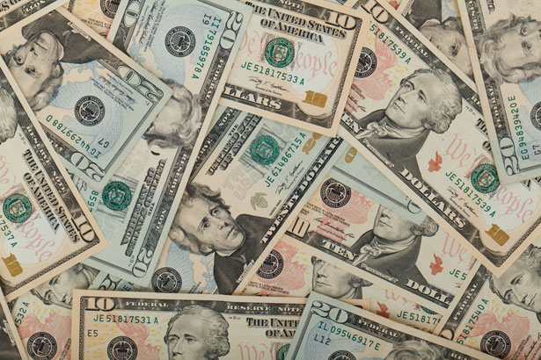
Treasurer’s report
1/15/2026
ASSETS
Checking/Savings
American Rescue Plan Fund 92,605.72
Capital Reserve - DPW 1,208.01
Capital Reserve - Police 7,089.82
Crime Watch Fund 222.69
General Fund - Community 60,500.16
General Fund - FNB 4,886.14
Holiday Lights Fund 400.59

Slide 4
Treasurer’s report
Investment - General Fund 1,173.59
Investment - Liquid Fuels 25,839.48
Investment - Paving Fund 1,185.80
Investment - Recycling 129.33
Investment - Refuse 184.80
Liquid Fuels - FNB 12,764.48
Petty Cash 194.00
Recreations Fund 21,933.80
Recycling - Community 10,103.23
Refuse Checking - FNB 130,835.75
Total Checking/Savings 371,257.39

Slide 5
Treasurer’s report
200000 · Accounts Payable 47,542.82
Long Term Debt 0

Slide 6


